Slide 1
HIIPER Lab Fall 2016
Kyle Stanevich

Slide 2
Overview
Helicon tube
Langmuir probe
RF power supply/Matching network
Miscellaneous lab tasks
Notes:
This presentation will go over what I did this past semester in the lab and what I learned along the way. Here are the main things that I worked on.
Misc. lab tasks includes running and servicing the chamber, reading equipment manuals, contacting customer service, and any other tasks Drew needed help with.

Slide 3
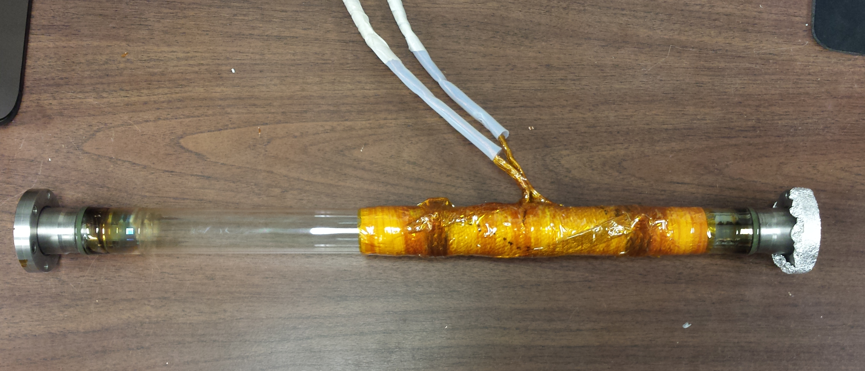
Helicon Antenna
Wrap a new Helicon
Match old design
More symmetrical
Thermal protection
Electrical protection
Notes:
The goal was the wrap a new antenna that would match the old design but tidy it up. The old design was not helicon shaped. Plus, the antenna had to be wrapped over a layer or fiberglass thermal strap/braiding. Then I needed to cover the entire thing with kapton tape so there would no electrical or thermal issues. The ends of the leads that connect to the matching network included plastic coverings, wrapped with fiberglass tape, wrapped with electrical tape. This is for safety so the RF leads will not arc or get touched.

Slide 4
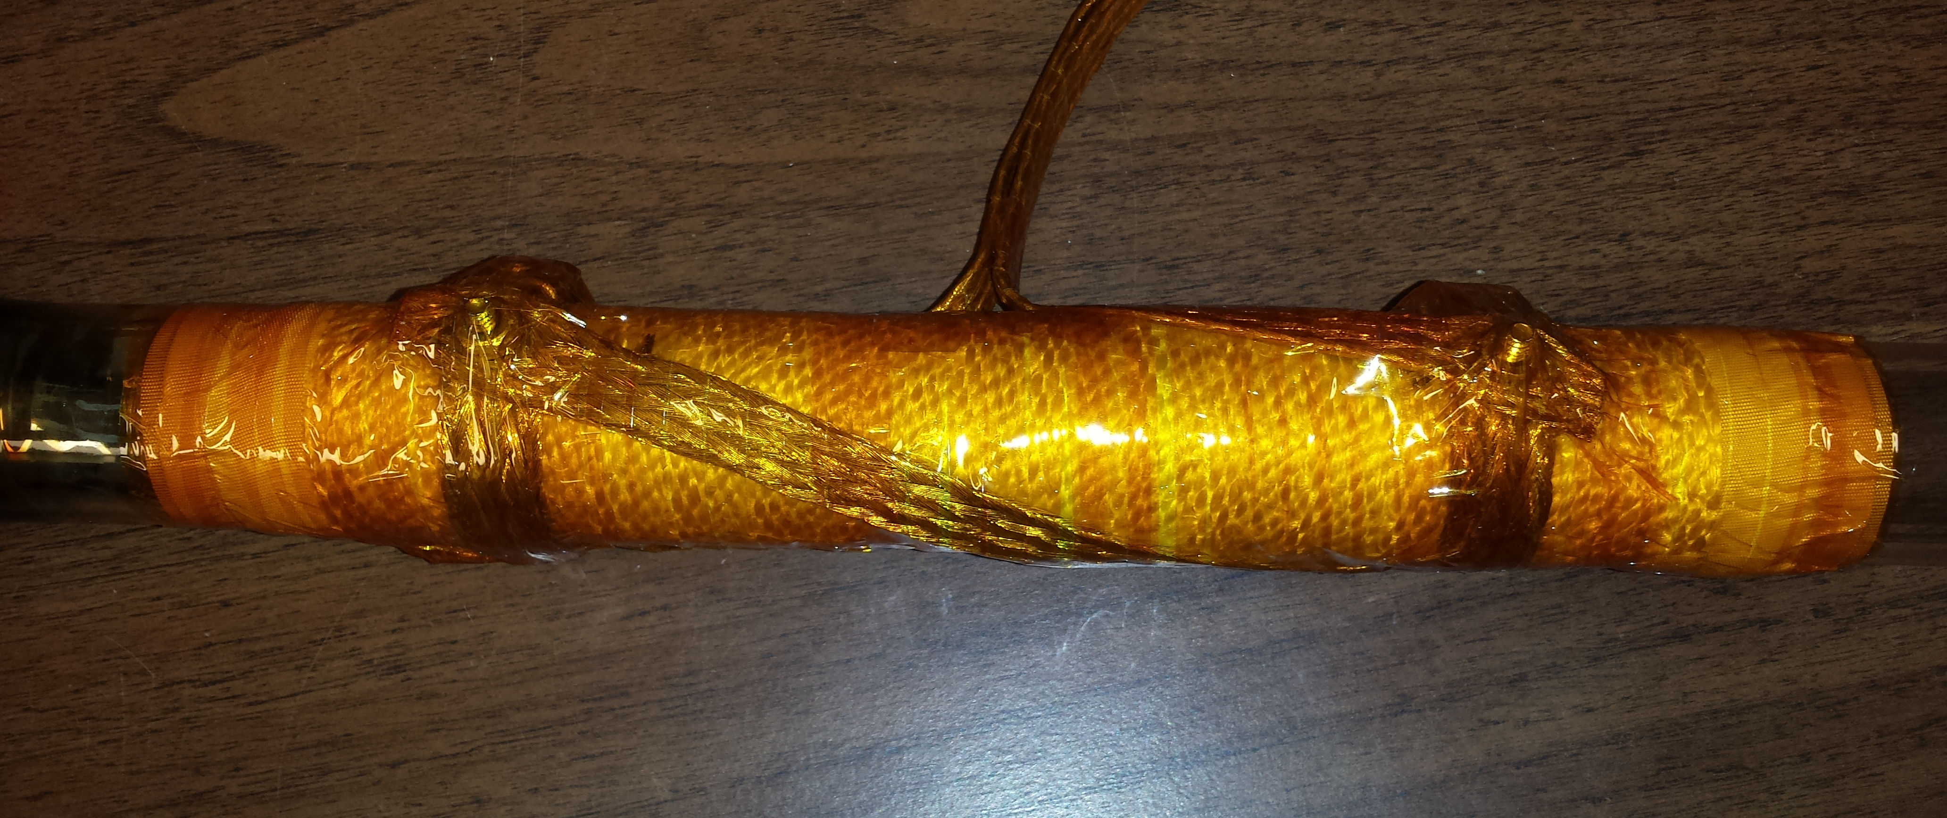
Helicon Antenna
First attempt was wrapped in opposite direction
Hard to work with copper strap
Used brass over stainless steel nuts and bolts
Better conductivity
Lower melting point
Notes:
I messed up the first design. I wrapped the helicon in the opposite direction than the previous design. Therefore I needed to re-wrap the antenna. It is hard to work with the copper strap and the clamps used to attach it to itself. On the second time around, I made sure to use all brass nuts and bolts because it has a much higher conductivity than the alternative stainless steel bolts. The only downside is that the melting point of brass is 900 C compared to 1500 C of stainless steel. However, the temperatures of the antenna don’t get nearly that hot. The first thing to melt would be the kapton tape at 260 C.
http://www.tibtech.com/conductivity.php

Slide 5
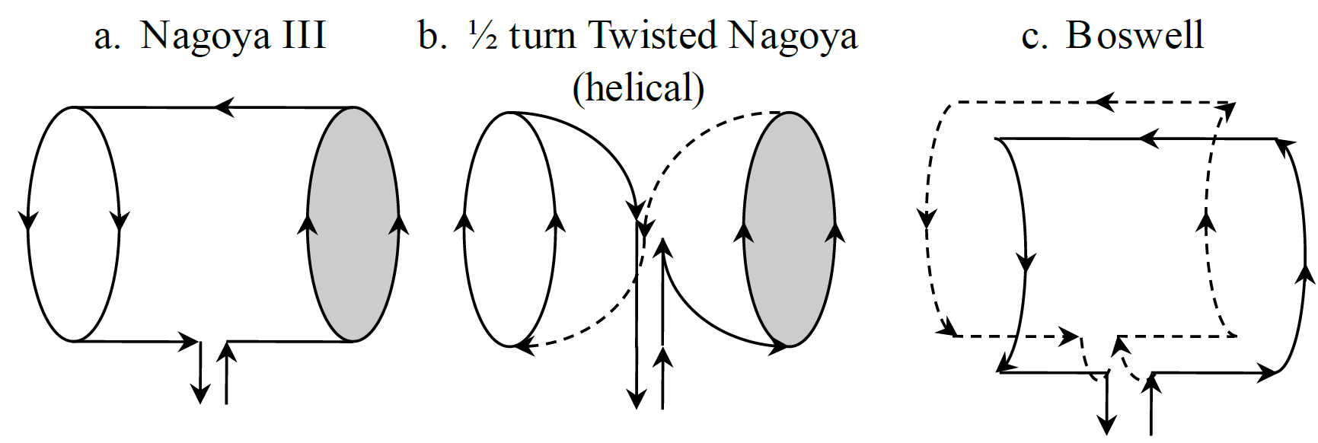
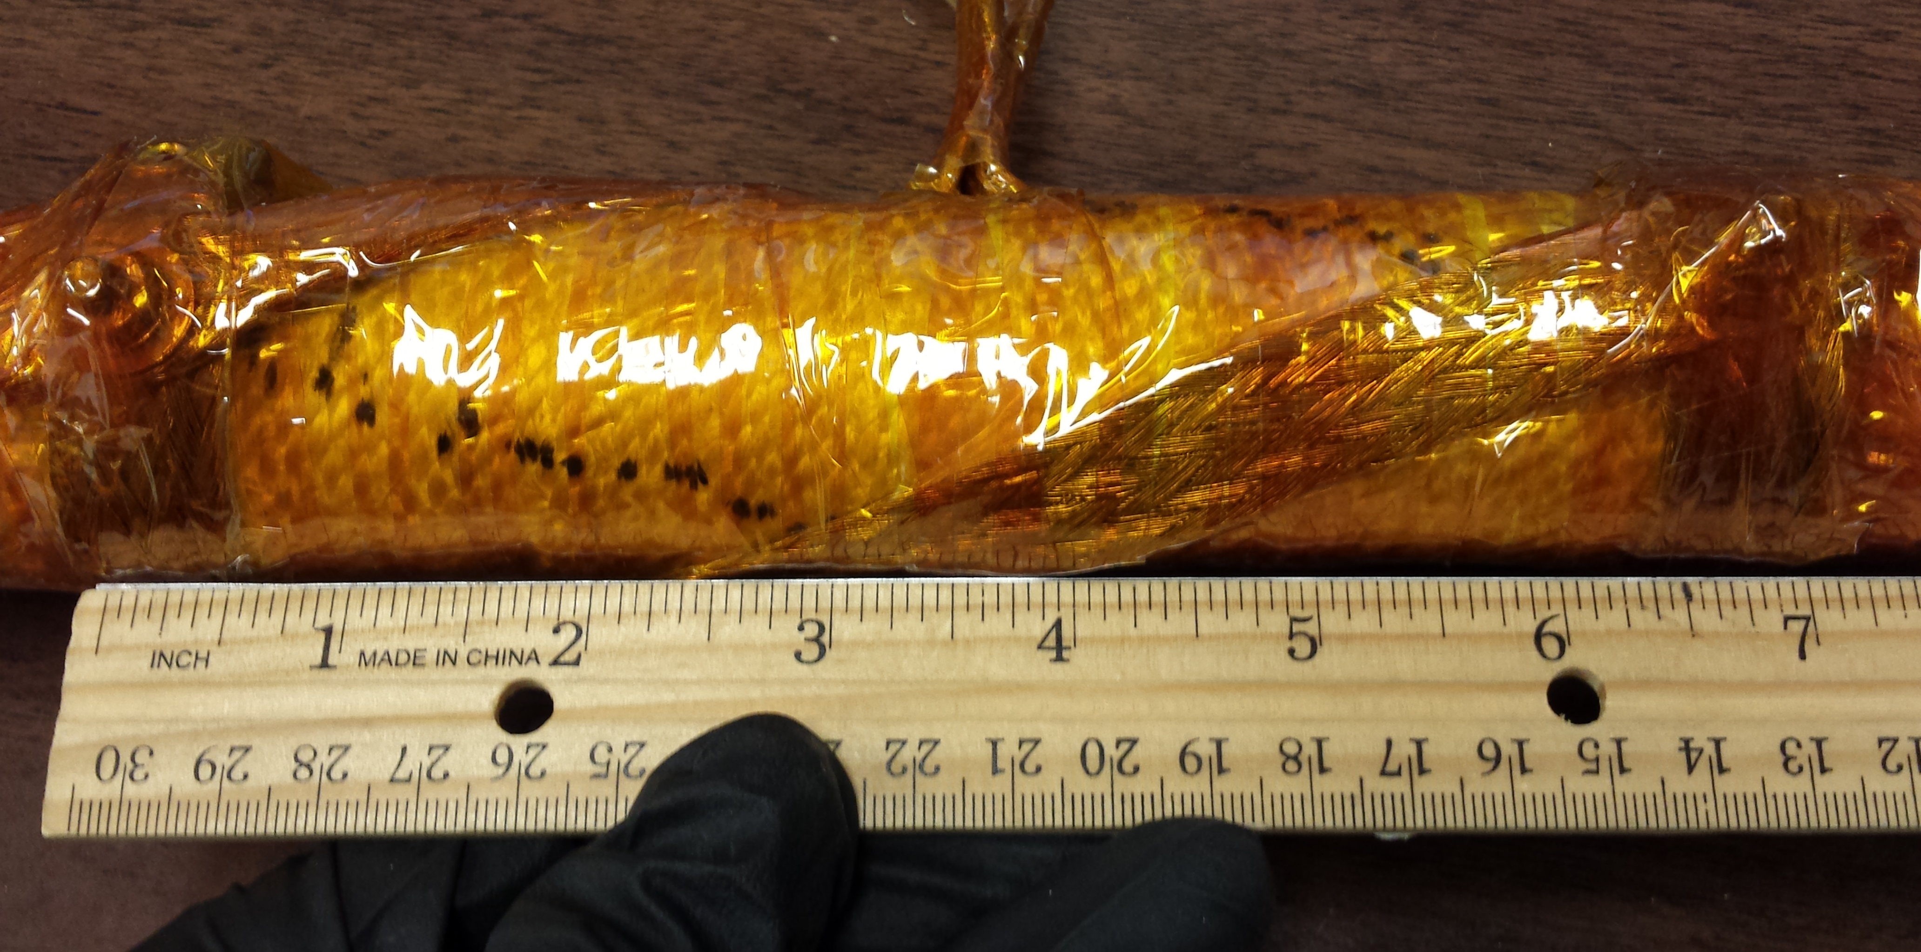
Helicon Antenna
There are alternative antenna designs
We use ½ turn Twisted Nagoya
7 inches between outer edges of strap
~1.5 inch diameter quartz tube

Slide 6
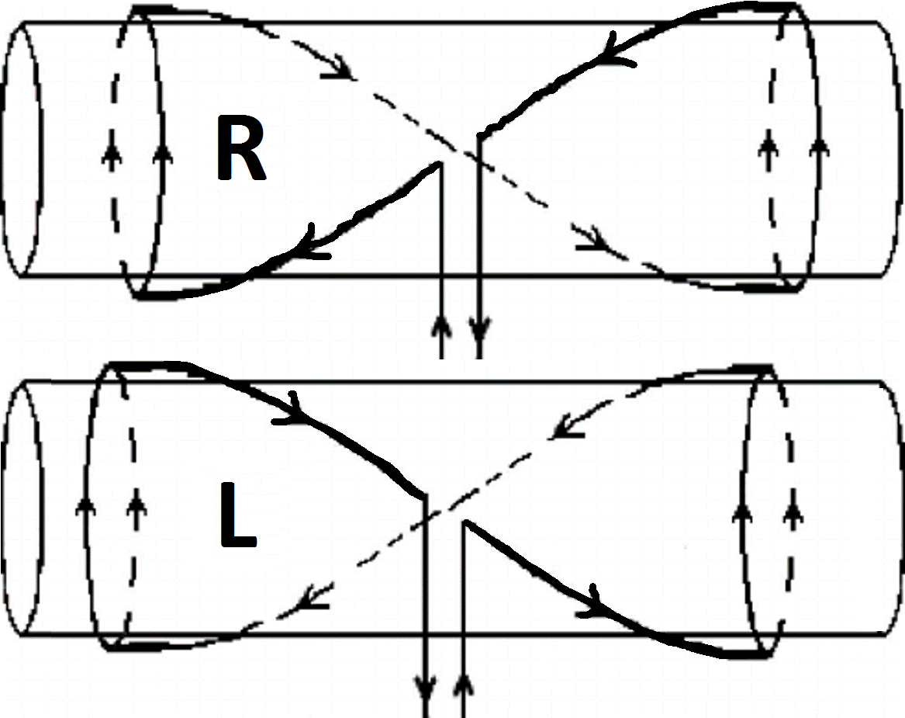
Helicon Antenna
Left hand vs right hand antenna
Direction of magnetic field (B)
Direction of helicon wave (k)
R with k parallel to B and L with k opposite B are equivalent (m=+1)
Cannot switch direction of B easily
B
(chamber)

Slide 7
Langmuir Probe
Use a Langmuir probe to measure plasma properties
The probe will pick up interference from the RF power supply
Need to add filters to remove RF interference
Filter out 13.56 MHz and the 2nd harmonic 27.12 MHz

Slide 8
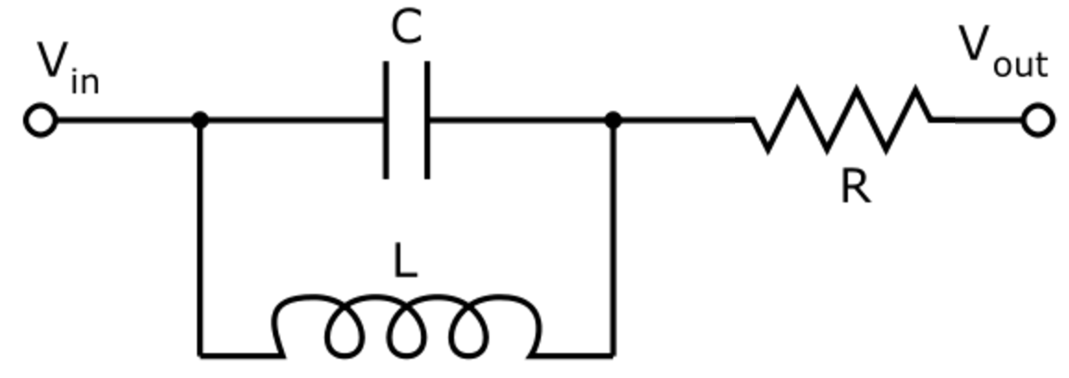
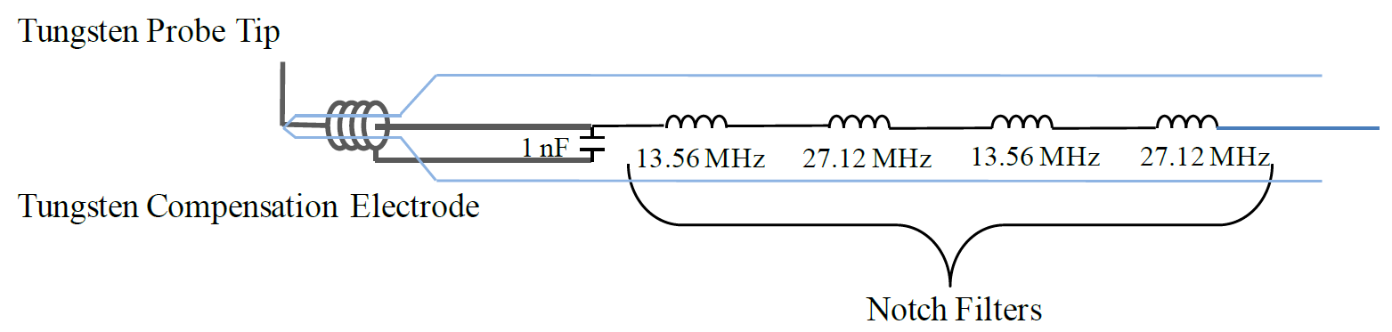
Langmuir Probe
Used 2 notch filters (band-stop filter)
13.56 MHz and 27.12 MHz
Capacitor and inductor in parallel

Slide 9
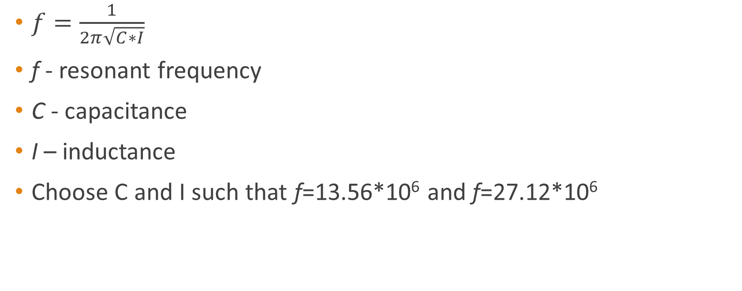
Langmuir Probe
$f=\frac{1}{2π\sqrt{C∗I}}$
f - resonant frequency
C - capacitance
I – inductance
Choose C and I such that f=13.56*10⁶ and f=27.12*10⁶

Slide 10
Langmuir Probe
Needed capacitors and inductors that fulfilled the following:
In stock at Grainger or Mouser
Big enough to solder
Matched the resonant frequencies 13.56 and 27.12 MHz
Spreadsheet of possible parts to buy
Test individual parts to find closest match

Slide 11
Langmuir Probe
See spreadsheet for more detail (lc circuit.xlsx)
C = 51 pF
I = 680 nH and 2.7 μH
C available (pF) | L required(nH) | Found inductor (nH) | f using found inductor (MHz) | Minimum tolerance needed
47 | 732.76 | 750 | 26.81 | 2%
50 | 688.80 | 680 | 27.29 | 1%
51 | 675.29 | 680 | 27.03 | 1%
56 | 615.00 | 620 | 27.01 | 1%
62 | 555.48 | 560 | 27.01 | 1%

Slide 12
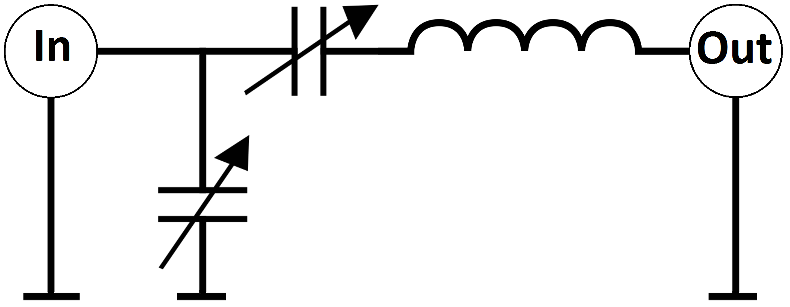
Matching Network
Tune and load capacitors
C1 – load (shunt)
C2 – tune
Adjust tune and load to minimize reflected power
Inductance changes with the addition of the magnetic field and IEC grid
C2
C1

Slide 13
References
Reilly, M.P. (2009). Three Dimensional Imaging of Helicon Wave Fields via Magnetic Induction Probes.
Chen, F.F., & Light, M. (1994). Helicon wave excitation with helical antennas.
Photos taken by Drew
MODEL MTK-600 Equipment manual

